Slide 1
COVID-19 Impact On Education

Slide 2
One year into the COVID-19 pandemic, close to half the world’s students are still affected by partial or full school closures, and over 100 million additional children will fall below the minimum proficiency level in reading as a result of the health crisis. Prioritizing education recovery is crucial to avoid a generational catastrophe as highlighted in a high-level ministerial meeting in March 2021.
UNESCO is supporting countries in their efforts to mitigate the impact of school closures, address learning losses and adapt education systems, particularly for vulnerable and disadvantaged communities.

Slide 3
Here, in order to figure out what can be done for all disadvantaged students, UNESCO conducted a data analysis and revealed how long schools were closed and how students' lives were affected and started looking for solutions
UNESCO has compiled data on school closures due to COVID-19 by date and country.
The categories tracked are:
Closed due to COVID-19
Academic break
Fully open
Partially open

Slide 4
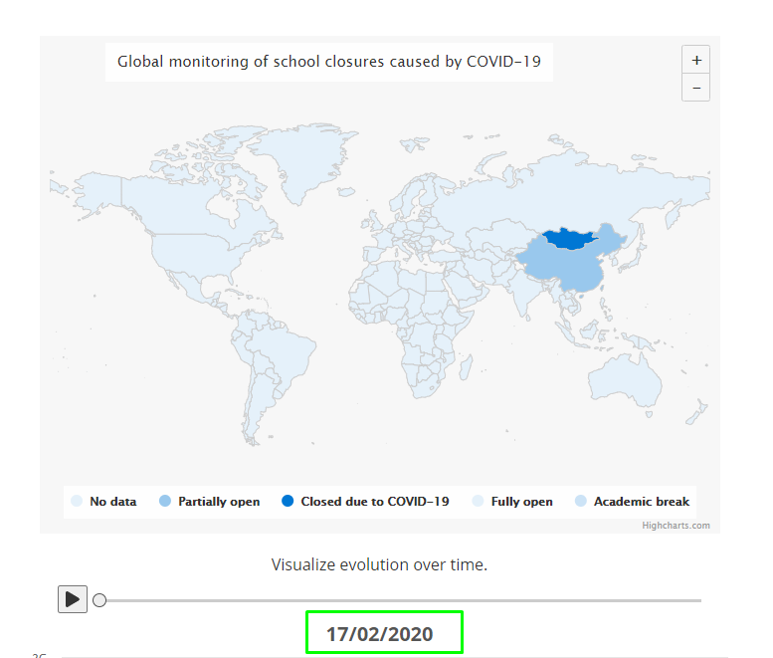
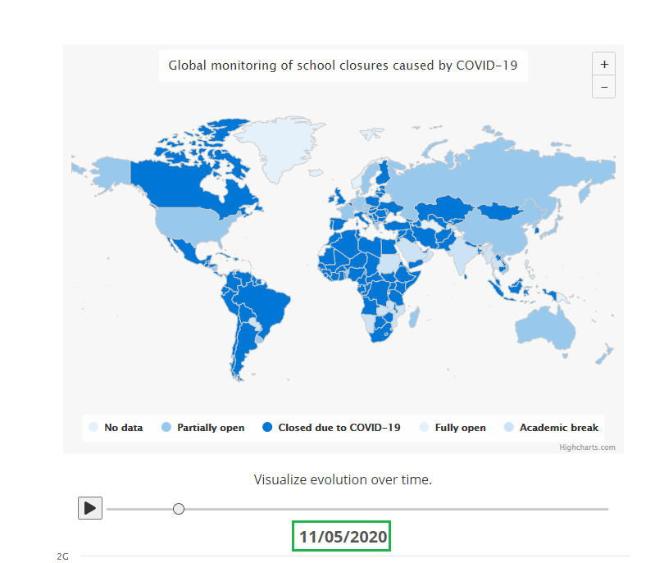
The effect of Covid 19 on education in 3 months

Slide 5
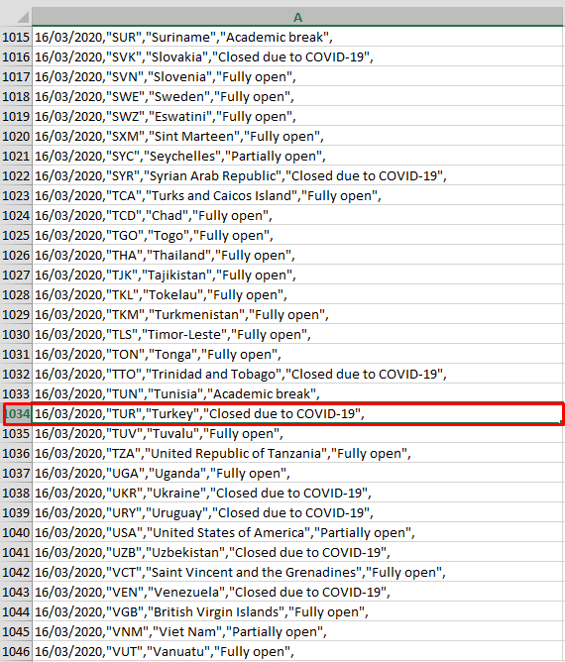
Closed due to COVID-19
Government-mandated closures of educational institutions affecting most or all of the student population enrolled from pre-primary through to upper secondary levels . In most cases, various distance learning strategies are deployed to ensure educational continuity.

Slide 6
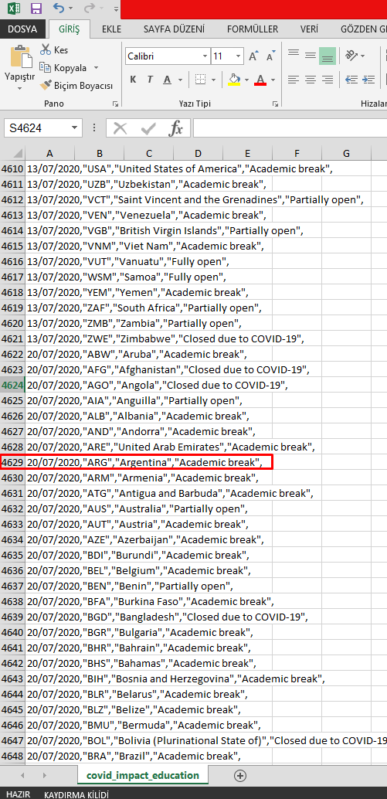
Academic break
Most schools across the country are on scheduled academic breaks for periods of at least four weeks. All study during this period is suspended.
The effects of Covid 19 in this period are not for education. Students whose social lives were affected could not have a productive interim period and could not receive an effective education with the opening of schools.

Slide 7
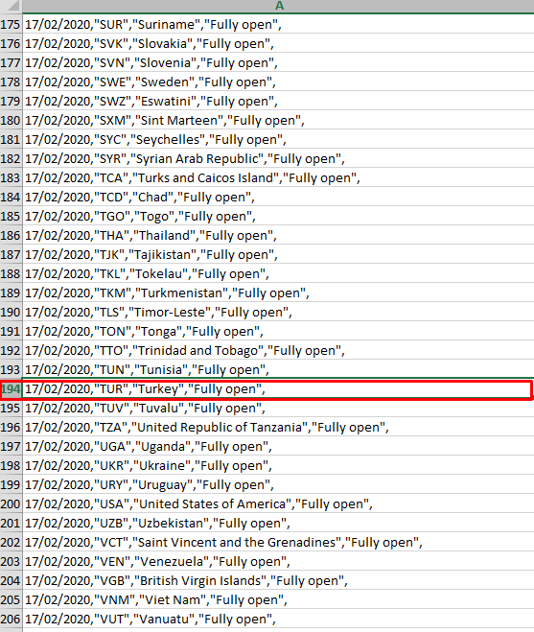
Fully open
For the majority of schools, classes are being held exclusively in person, noting that measures to ensure safety and hygiene in schools vary considerably from context to context and/or by level of education.
Even though education and training continued in this period, the students who went to school could not have a productive period because they went to school with the fear of getting sick.

Slide 8
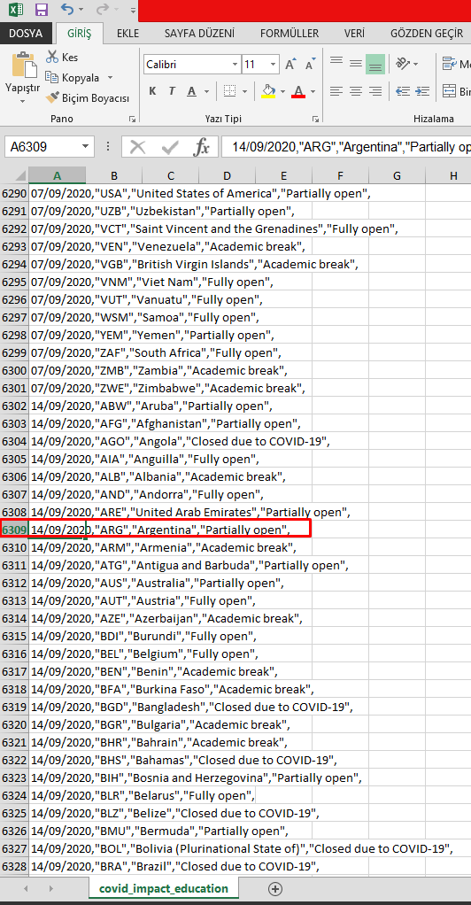
Partially open
Governments have mandated (a) partial reopening in certain areas, and/or (b) a phased re-opening by grade level or age and/or (c) the use of a hybrid approach combining in-person and distance learning. It also includes the countries where national governments have deferred decisions on re-opening to other administrative units (e.g. region, municipality or individual schools), and where a variety of re-opening modalities are being used.

Slide 9
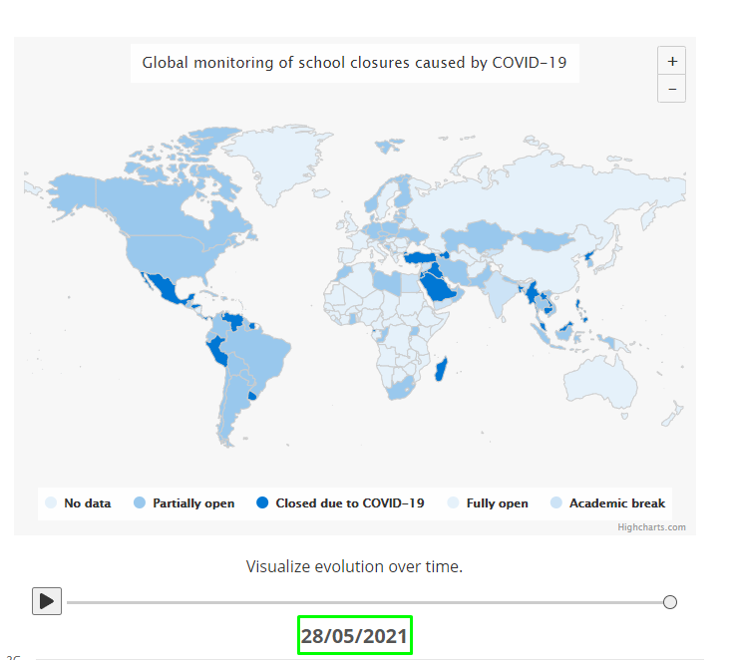
Although education and training tried to continue, the problems that arose kept students away from a correct education.

